Slide 1









Magnum Opus’
Presentation
10:00 AM
2022-10-25

Slide 2
EZ Learning 2.0 Prototype
10:00 AM
2022-10-25
Made with PowerPoint

Slide 3
EZ Learning 2.0 Prototype
10:00 AM
2022-10-25
Made with PowerPoint

Slide 4

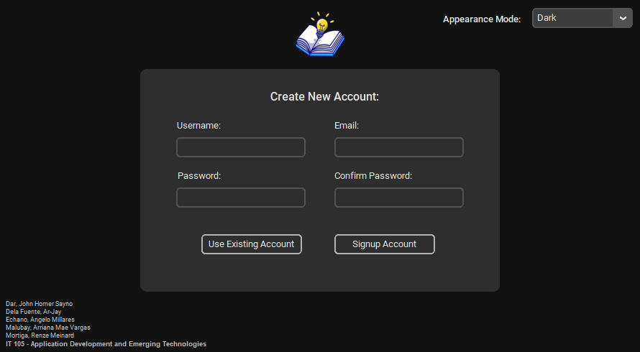
EZ Learning 2.0
Signup Account Feature

Slide 5
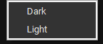
EZ Learning 2.0
Signup Account Feature

Slide 6
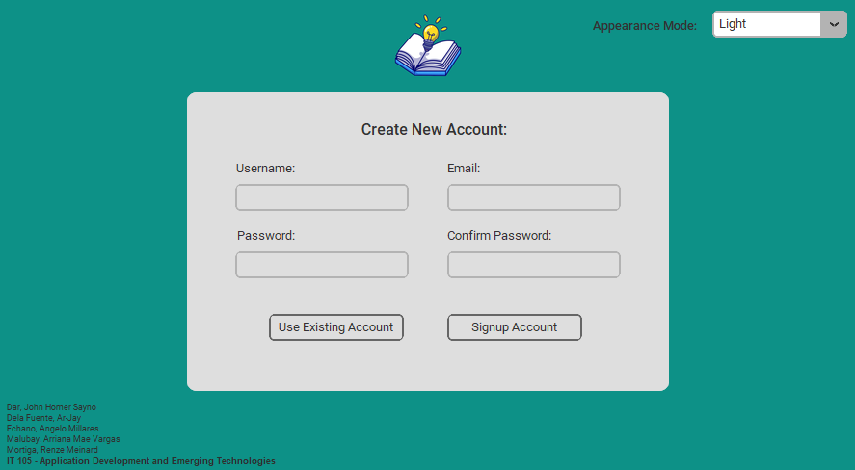
EZ Learning 2.0
Appearance Mode Feature

Slide 7
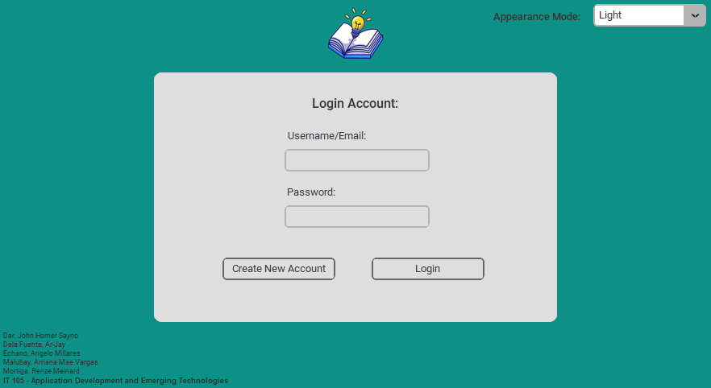
EZ Learning 2.0
Login Account Feature

Slide 8
EZ Learning 2.0
ezlearning2.0@gmail.com
strongpassword123@#$
Login Account Feature

Slide 9

EZ Learning 2.0
Search your notes
Notes
Quizzes
Select
Mathematics
Science
English
Filipino
History
Physical Education
Application Development
HCI
Operating Systems
Information Management
Ethics
STS
Notes Dashboard Feature

Slide 10
EZ Learning 2.0
Search your notes
Application Development
Emerging Technologies
SOLID Principles
Prototypes
Software Development
Data Flow Diagram
Notes Feature

Slide 11
EZ Learning 2.0
Search your notes
Application Development
Emerging Technologies
SOLID Principles
Prototypes
Software Development
Data Flow Diagram
Notes Feature

Slide 12
EZ Learning 2.0
Search your notes
Application Development
Emerging Technologies
SOLID Principles
Prototypes
Software Development
Data Flow Diagram
Notes Feature

Slide 13
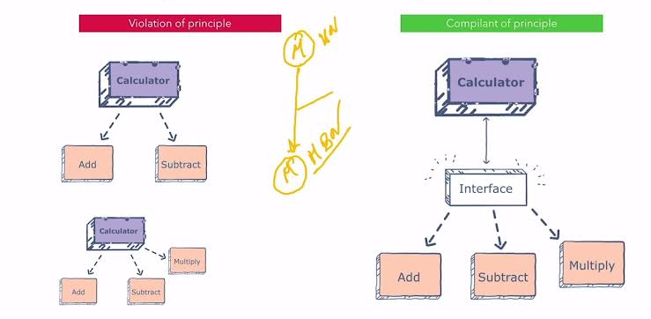
EZ Learning 2.0
SOLID Principles
SOLID Principles
Entities must depend on abstractions, not on concretions.
This principle states that the high-level module must not depend on the low-level module, but they should depend on abstractions.
Edit Notes Feature

Slide 14
EZ Learning 2.0
SOLID Principles
SOLID Principles
Entities must depend on abstractions, not on concretions.
Link Copied to Clipboard.
Share this to your friends.
This principle states that the high-level module must not depend on the low-level module, but they should depend on abstractions.
Edit Notes Feature

Slide 15
EZ Learning 2.0
SOLID Principles
SOLID Principles
Entities must depend on abstractions, not on concretions.
This principle states that the high-level module must not depend on the low-level module, but they should depend on abstractions.
Edit Notes Feature

Slide 16
EZ Learning 2.0
SOLID Principles
Notes
Quizzes
Trash
Profile Settings
Logout
SOLID Principles
SOLID Principles
Entities must depend on abstractions, not on concretions.
Mathematics
Science
Application Development
HCI
This principle states that the high-level module must not depend on the low-level module, but they should depend on abstractions.
Magnum Opus
Edit Notes Feature

Slide 17
EZ Learning 2.0
Search your quizzes
Search your quizzes
Notes
Quizzes
Trash
Profile Settings
Logout
Notes
Quizzes
Select
Mathematics
Science
English
Filipino
History
Physical Education
Application Development
HCI
Operating Systems
Information Management
Ethics
STS
Magnum Opus
Three-Line Menu Feature

Slide 18
EZ Learning 2.0
Search your quizzes
Notes
Quizzes
Select
Mathematics
Science
English
Filipino
History
Physical Education
Application Development
HCI
Operating Systems
Information Management
Ethics
STS
Quizzes Dashboard Feature

Slide 19
EZ Learning 2.0
Search your notes
Notes
Quizzes
Select
Mathematics
Science
English
Filipino
History
Physical Education
Application Development
HCI
Operating Systems
Information Management
Ethics
STS
Notes Dashboard Feature

Slide 20
EZ Learning 2.0
Search your quizzes
Notes
Quizzes
Select
Mathematics
Science
English
Filipino
History
Physical Education
Application Development
HCI
Operating Systems
Information Management
Ethics
STS
Quizzes Dashboard Feature

Slide 21
EZ Learning 2.0
Search your quizzes
Application Development
Emerging Technologies
SOLID Principles
Prototypes
Software Development
Data Flow Diagram
Quizzes Feature

Slide 22
EZ Learning 2.0
Search your quizzes
Application Development
Emerging Technologies
SOLID Principles
Prototypes
Software Development
Data Flow Diagram
Quizzes Feature

Slide 23
EZ Learning 2.0
Search your quizzes
Application Development
Emerging Technologies
SOLID Principles
Prototypes
Software Development
Data Flow Diagram
Quizzes Feature

Slide 24
EZ Learning 2.0
Emerging Technologies
Question:
Allows a system to recognize users by biological markets such as their face, voice, or fingerprint.
Quiz Method:
Identification
Multiple Choice
True or False
Answer:
Biometrics
1
2
3
Add question…
Edit Quiz Feature

Slide 25
EZ Learning 2.0
Emerging Technologies
Question:
Systems that are effectively censorship proof of seizure resistant wherein the Government can’t come and take your asset if you’re in a country that has very bad governance.
Quiz Method:
Identification
Multiple Choice
True or False
Answer:
Answer: Blockchain
Choices: Artificial Intelligence, Serverless Computing, Biometrics
1
2
3
Add question…
Edit Quiz Feature

Slide 26
EZ Learning 2.0
Emerging Technologies
Question:
The holy grail of artificial intelligence research is general AI, a machine that is self-aware and commands intelligence equal to a people.
Quiz Method:
Identification
Multiple Choice
True or False
Answer:
True False
1
2
3
Add question…
Edit Quiz Feature

Slide 27
EZ Learning 2.0
Emerging Technologies
Question:
The holy grail of artificial intelligence research is general AI, a machine that is self-aware and commands intelligence equal to a people.
Quiz Method:
Identification
Multiple Choice
True or False
Shuffle Quiz?
Answer:
Yes
No
True False
1
2
3
Add question…
Edit Quiz Feature

Slide 28
EZ Learning 2.0
Emerging Technologies
Question:
The holy grail of artificial intelligence research is general AI, a machine that is self-aware and commands intelligence equal to a people.
Quiz Method:
Identification
Multiple Choice
True or False
Shuffle Quiz?
Answer:
Yes
No
True False
1
2
3
Add question…
Edit Quiz Feature

Slide 29
EZ Learning 2.0
Emerging Technologies
Systems that are effectively censorship proof of seizure resistant wherein the Government can’t come and take your asset if you’re in a country that has very bad governance.
b. Blockchain
d. Serverless Computing
a. Artificial Intelligence
c. Biometrics
Play Quiz Feature

Slide 30
EZ Learning 2.0
Emerging Technologies
The holy grail of artificial intelligence research is general AI, a machine that is self-aware and commands intelligence equal to a people.
True
False
Play Quiz Feature

Slide 31
EZ Learning 2.0
Emerging Technologies
Systems that are effectively censorship proof of seizure resistant wherein the Government can’t come and take your asset if you’re in a country that has very bad governance.
b. Blockchain
d. Serverless Computing
a. Artificial Intelligence
c. Biometrics
Play Quiz Feature

Slide 32
EZ Learning 2.0
Emerging Technologies
The holy grail of artificial intelligence research is general AI, a machine that is self-aware and commands intelligence equal to a people.
True
False
Play Quiz Feature

Slide 33
EZ Learning 2.0
Emerging Technologies
Allows a system to recognize users by biological markets such as their face, voice, or fingerprint.
Biometrics
Play Quiz Feature

Slide 34
EZ Learning 2.0
Emerging Technologies
Allows a system to recognize users by biological markets such as their face, voice, or fingerprint.
Quiz Ended See Results?
Biometrics
No
Yes
See Results Feature

Slide 35
EZ Learning 2.0
Emerging Technologies
Allows a system to recognize users by biological markets such as their face, voice, or fingerprint.
Quiz Ended See Results?
Biometrics
No
Yes
See Results Feature

Slide 36
EZ Learning 2.0
Emerging Technologies
Time Taken | Score | Total | Passing Rate
2022-10-25 | 3 | 3 | 100%
Statistics Feature

Slide 37
EZ Learning 2.0
Search your quizzes
Search your quizzes
Emerging Technologies
Notes
Quizzes
Trash
Profile Settings
Logout
Time Taken | Score | Total | Passing Rate
2022-10-25 | 3 | 3 | 100%
Mathematics
Science
Application Development
HCI
Magnum Opus
Three-line Menu Feature

Slide 38
EZ Learning 2.0
Search your trash
Search your quizzes
Search your quizzes
Search your quizzes
Notes
Quizzes
Trash
Profile Settings
Logout
Trash
Q
N
Physical Education
N
Physical Education
N
Q
Q
Physical Education
History of PE
Basics of Tennis
Midterms in PE
Physical Education
Physical Education
Warm Ups
Physical Education
Badminton
Mathematics
Science
Prelims in PE
Olympics
N
Q
Olympics
Music and Arts
Stretching Basics
Prelims in PE
Olympics
Musical Notes
Types of Arts
Prelims in PE
Music and Arts
Application Development
HCI
Reporting Script
HCI Proposal
Magnum Opus
Trash Feature
Reporting
Reporting
HCI Proposal
HCI Proposal
Prototyping

Slide 39
EZ Learning 2.0
Search your trash
Trash
Q
N
Physical Education
Physical Education
Warm Ups
Badminton
History of PE
Basics of Tennis
Midterms in PE
N
Q
Prelims in PE
Olympics
Music and Arts
Musical Notes
Types of Arts
Music and Arts
Stretching Basics
Trash Feature
Reporting
HCI Proposal
Prototyping

Slide 40
EZ Learning 2.0
Search your trash
Trash
✓
Q
N
Physical Education
Physical Education
Warm Ups
Badminton
History of PE
Basics of Tennis
Midterms in PE
N
Q
Prelims in PE
Olympics
Music and Arts
Musical Notes
Types of Arts
Music and Arts
Stretching Basics
Trash Feature
Reporting
HCI Proposal
Prototyping

Slide 41
EZ Learning 2.0
Search your trash
Trash
✓
✓
Q
N
Physical Education
Physical Education
Warm Ups
Badminton
History of PE
Basics of Tennis
Midterms in PE
N
Q
Prelims in PE
Olympics
Music and Arts
Musical Notes
Types of Arts
Music and Arts
Stretching Basics
Trash Feature
Reporting
HCI Proposal
Prototyping

Slide 42
EZ Learning 2.0
Search your trash
Trash
✓
✓
Q
N
Physical Education
Physical Education
Warm Ups
Badminton
History of PE
Basics of Tennis
Midterms in PE
✓
N
Q
Prelims in PE
Olympics
Music and Arts
Musical Notes
Types of Arts
Music and Arts
Stretching Basics
Trash Feature
Reporting
HCI Proposal
Prototyping

Slide 43
EZ Learning 2.0
Search your trash
Trash
✓
✓
Q
N
Physical Education
Physical Education
Warm Ups
Badminton
History of PE
Basics of Tennis
Midterms in PE
Are you sure you want to permanently delete these files?
✓
Yes
No
N
Q
Prelims in PE
Olympics
Music and Arts
Musical Notes
Types of Arts
Music and Arts
Stretching Basics
Trash Feature
Reporting
HCI Proposal
Prototyping

Slide 44
EZ Learning 2.0
Search your trash
Trash
✓
✓
Q
N
Physical Education
Physical Education
Warm Ups
Badminton
History of PE
Basics of Tennis
Midterms in PE
Are you sure you want to permanently delete these files?
✓
Yes
No
N
Q
Prelims in PE
Olympics
Music and Arts
Musical Notes
Types of Arts
Music and Arts
Stretching Basics
Trash Feature
Reporting
HCI Proposal
Prototyping

Slide 45
EZ Learning 2.0
Search your trash
Trash
N
Warm Ups
Badminton
History of PE
Basics of Tennis
Midterms in PE
Olympics
Music and Arts
Q
Musical Notes
Types of Arts
Music and Arts
Stretching Basics
Reporting
HCI Proposal
Prototyping
Trash Feature

Slide 46
EZ Learning 2.0
Search your trash
Notes
Quizzes
Trash
Profile Settings
Logout
Trash
Trash
Q
N
Physical Education
N
N
Physical Education
N
Q
Q
Physical Education
History of PE
Basics of Tennis
Midterms in PE
Olympics
Music and Arts
Warm Ups
Physical Education
Physical Education
Physical Education
Badminton
Mathematics
Science
Prelims in PE
Olympics
Q
Olympics
Music and Arts
Stretching Basics
Reporting
HCI Proposal
Prototyping
Olympics
Musical Notes
Types of Arts
Prelims in PE
Prelims in PE
Application Development
HCI
Reporting Script
HCI Proposal
Magnum Opus
Trash Feature
Reporting
Reporting
HCI Proposal
HCI Proposal

Slide 47
EZ Learning 2.0
Search your quizzes
Search your quizzes
Search your quizzes
Notes
Quizzes
Trash
Profile Settings
Logout
Magnum Opus
Q
N
ezlearning2.0@gmail.com
Physical Education
Physical Education
N
Q
Change Username
Physical Education
Physical Education
Mathematics
Science
Change Password
Prelims in PE
Olympics
Change Profile Picture
Prelims in PE
Olympics
Application Development
HCI
Delete Account
Reporting Script
HCI Proposal
Magnum Opus
Profile Settings Feature
Reporting
HCI Proposal

Slide 48
EZ Learning 2.0
Magnum Opus
ezlearning2.0@gmail.com
Change Username
Change Password
Change Profile Picture
Delete Account
Profile Settings Feature

Slide 49
EZ Learning 2.0
Magnum Opus
ezlearning2.0@gmail.com
Change Username
Change Password
Change Profile Picture
Delete Account
Profile Settings Feature

Slide 50
EZ Learning 2.0
Magnum Opus
ezlearning2.0@gmail.com
Change Username
Change Password
Change Profile Picture
Delete Account
Profile Settings Feature

Slide 51
EZ Learning 2.0
Magnum Opus
ezlearning2.0@gmail.com
Change Username
Change Password
Change Profile Picture
Delete Account
Profile Settings Feature

Slide 52
EZ Learning 2.0
Magnum Opus
ezlearning2.0@gmail.com
Change Username
Change Password
Change Profile Picture
Delete Account
Profile Settings Feature

Slide 53
EZ Learning 2.0
Search your quizzes
Search your quizzes
Search your quizzes
Notes
Quizzes
Trash
Profile Settings
Logout
Magnum Opus
Q
N
ezlearning2.0@gmail.com
Physical Education
Physical Education
N
Q
Change Username
Physical Education
Physical Education
Mathematics
Science
Change Password
Prelims in PE
Olympics
Change Profile Picture
Prelims in PE
Olympics
Application Development
HCI
Delete Account
Reporting Script
HCI Proposal
Magnum Opus
Profile Settings Feature
Reporting
HCI Proposal

Slide 54
EZ Learning 2.0 Prototype
10:00 AM
2022-10-25
Magnum Opus. Thank you!

